Slide 1






Slide 2
Index
Introduction
Abstract
Contents
Key Words
Main Module
System Requirements
Face Recognition Techniques
Face detection as a pattern-classification task
Controlled background
By colour
By motion
Model-based
Geometric Features
UML Diagram
Class Diagram
Use case Diagram
Block Diagram
Snapshot
Conclusion

Slide 3
Introduction
Face plays a big role in conveying identity and emotion, being the primary focus of attention in social life.
Also, familiar faces can be identified at a glance even after years of separation.
Computational model of face recognition can be applied to criminal identification, security systems, image and film processing and human computer interaction.

Slide 4
Continuous
This is a challenging problem because faces have a high degree of variability in size, shape, colour and texture, multi dimensional.
The approach treats the face recognition problem as two dimensional recognition problem.
Thus, a fast and an efficient face detection system using Haar Classifier approach, a face recognition system based on Eigen face which relies on Principal Component Analysis (PCA) and a face tracking system based on Haar Cascade Classifier is implemented.
We use the software Open source Computer Vision (OpenCV)
library.

Slide 5
Abstract
Face
recognition have been fast growing, challenging and
interesting area in real-time applications.
A large number of face recognition algorithms have been developed from implementations. The present paper primarily focuses on principal component analysis, for the analysis,
The software is implemented using C#.NET.
This face recognition system detects the faces in a picture taken by web-cam, and these face images are then checked with training image dataset based on Eigen features. Eigen features are used to characterize images.

Slide 6
Keywords
Eigen Faces
Eigen Values PCA ( Principal Component Analysis )
Face Recognition
Person Identification
Face Classification

Slide 7
Main Modules
Face Detection
Eyes Detection
Apply Bezier Curve on Eye
Lip Detection
Apply Bezier Curve on Lip
Skin Colour Segmentation
Database and Training
Emotion Detection

Slide 8
System Requirements
Hardware Requirements:
Processor
Hard Disk
Display
Accessories
RAM
: Intel Dual Core or Advance.
: Minimum 80 GB.
: LCD/LED Colour.
: Web Cam, Keyboard & Mouse.
: Minimum 1 GB.
Software Requirements:
Operating system :
Microsoft Windows 7 or Higher Versions. ASP .NET with C#
MySQL 10G
Programming Language :
Database :

Slide 9
Face Recognition
Process of Face recognition
The face image captured is now used in the face recognition
process.
This face image is analysed and considered as a high- dimensional vector.
This vector is then compared to all the face images in the database, looking for a match.

Slide 10
Authentication system
The face recognition system will be integrated with PC’s authentication system. If a match is found for the face image than it will log that user on.
The camera will be capturing images in real-time so if a enrolled face is not detected in front of the computer, the user is logged off.

Slide 11
Face Recognition Techniques
Face detection as a pattern-classification task
Controlled background
By colour
By motion
Model-based
Geometric Features

Slide 12
FACE RECOGNITION TECHNIQUES
By colour:
This technique is vulnerable. In this skin colour is used to segment the colour image to find the face in the image. But this has some drawback; the still background of the same colour will also be segmented.
By motion:
The face in the image is usually in motion. Calculating the moving area will
get the face segment.
There are also many disadvantages as there may be backgrounds which are in motion.

Slide 13
Continuous
As a pattern classification task:
In this face detection is a binary-pattern classification task. That is, the content of a given part often image is transformed into features, after which a classifier trained on example faces decides whether that particular region of the image is a face, or not.
Controlled background:
In this technique the background is still or is fixed. Remove the background and only the faces will be left, assuming the image only contains a frontal face.
Model-based:
A face model can contain the appearance, shape, and motion of faces.
This technique uses the face model to find the face in the image. Some of the models can be rectangle, round, square, heart, and triangle. It gives high level of accuracy if used with some other techniques.

Slide 14
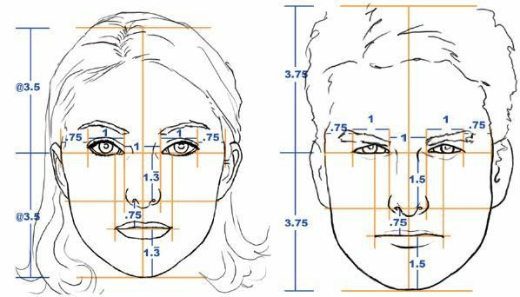
Continuous
Geometric Features
Face height/ Face width
Lips-where the eyebrow joint/Length of nose
Distance of between pupils/distance of between two eyebrow
Face height/the border of end point of chain
between eyebrow
Nose weight/distance of between two nostrils
Some ratios belong to head with face:
Human eyes are located in half of head length
Mouth, chin, and nose width is almost the same
The width of each eye is width of the face 2/5 times as much
The distance between the two eyes is the length of an eye

Slide 15
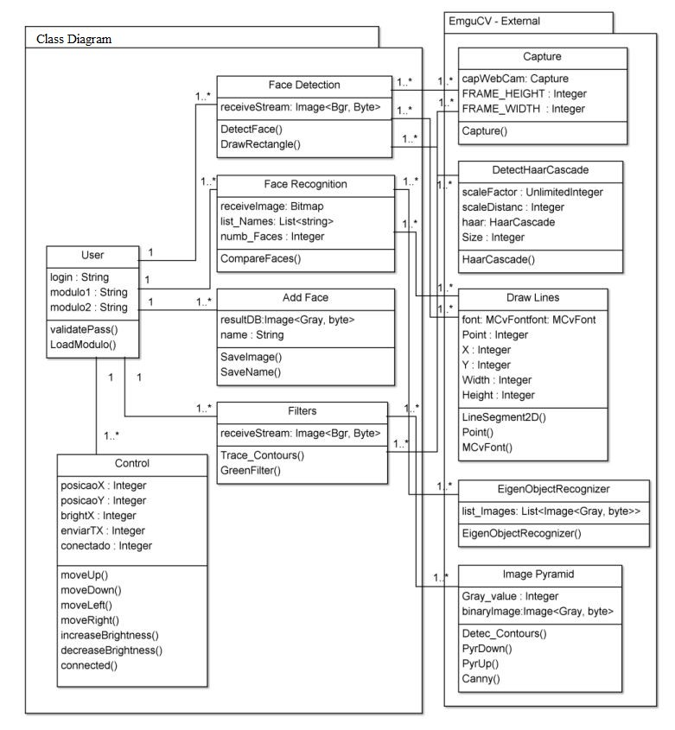
Class Diagram

Slide 16
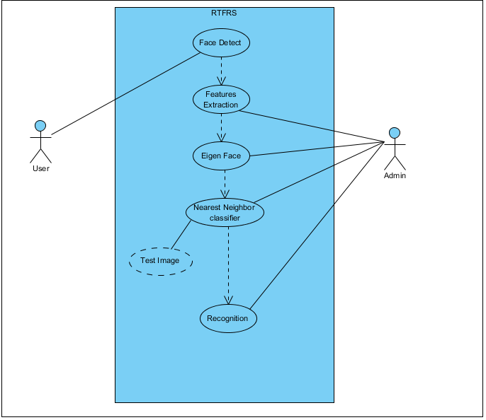
Usecase Diagram

Slide 17
Block Diagram Of Face Recognition
Web Cam
Face
Detection
Face Images
Data Base
Database
Features
Extraction
Eigen Faces
Test Images
Nearest Neighbor classifier
Recognition

Slide 18
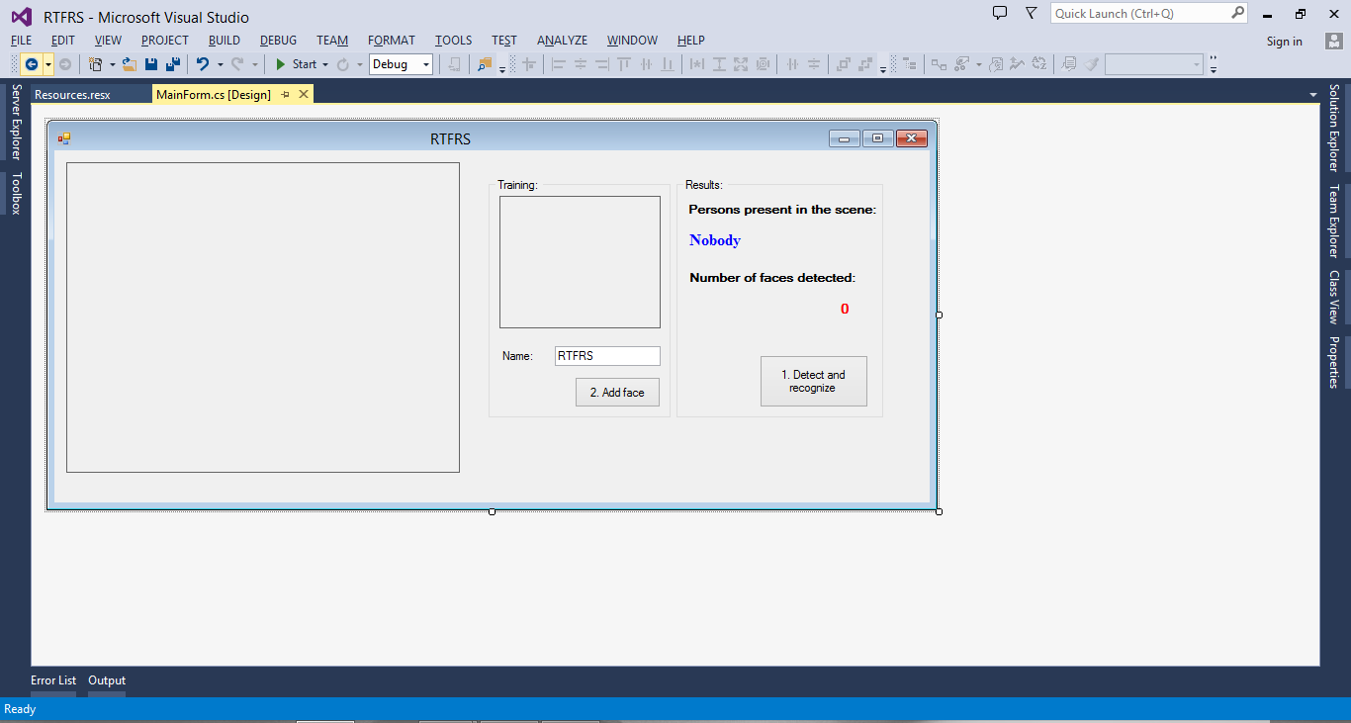
Image Detector
Image
Grabber
Start

Slide 19
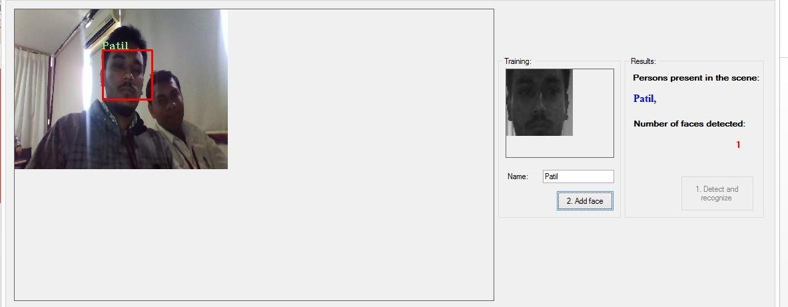

Slide 20
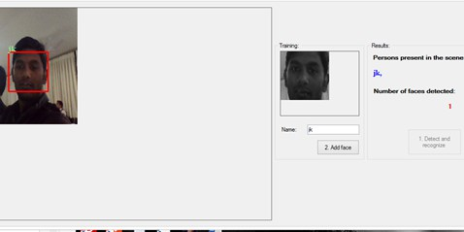

Slide 21
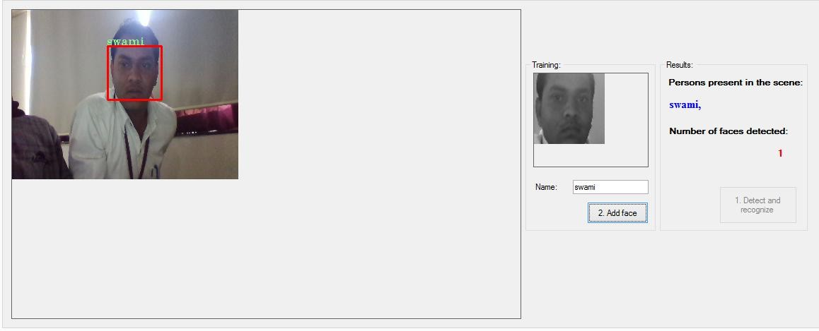

Slide 22
Conclusion
.NET is really a powerful programming language for image acquiring and image processing.
PNG is the format that should be used for image processing.
Our face recognition system detects the faces in a picture taken by web-cam, and these face images are then checked with training image dataset based on Eigen features. Eigen features are used to characterize images.
Finally Our Team would like to thank Mr Shakti Patel for their kind help and valuable suggestions.

Slide 23
THANK YOU…
[Any Questions ?]

